Slide 1
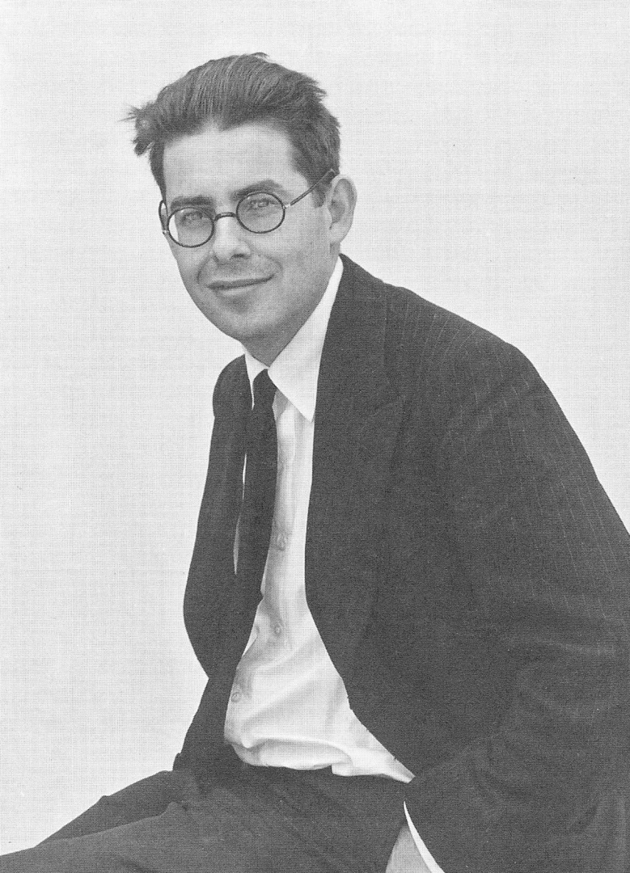

Slide 2
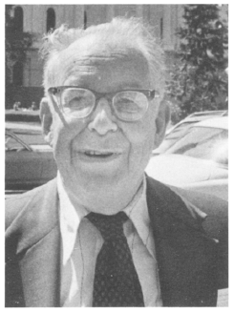
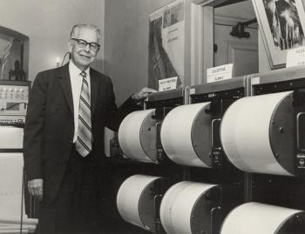
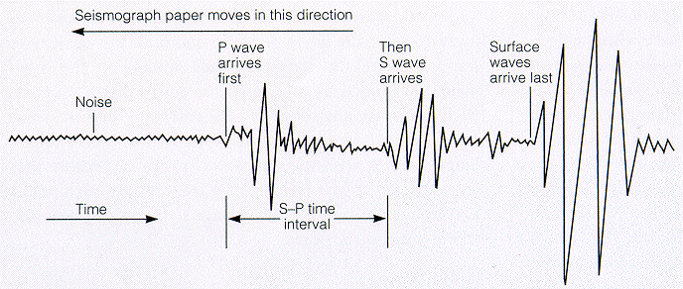
Charles Richter

Slide 3
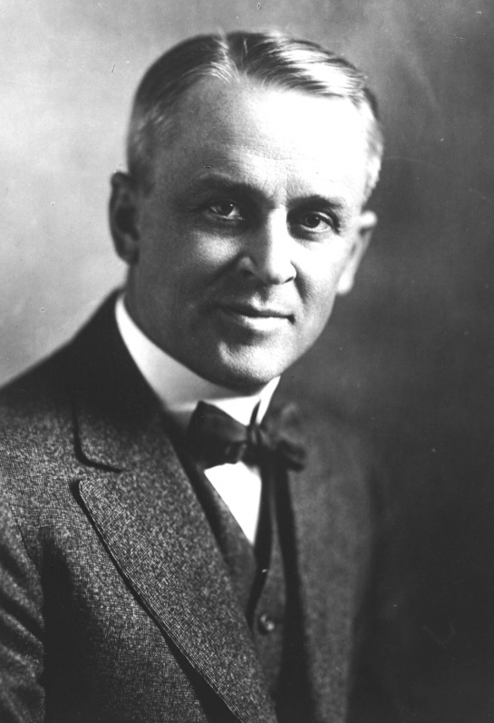
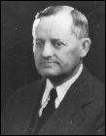
Harry O. Wood
Robert Millikan

Slide 4
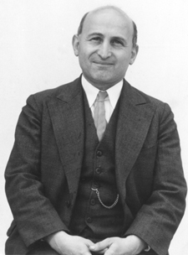
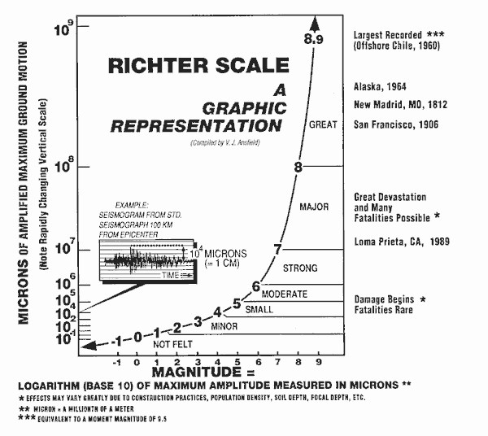
‘Richter’ Scale with Beno Gutenberg

Slide 5
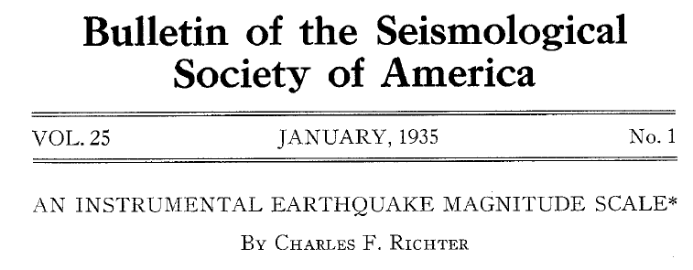

Slide 6
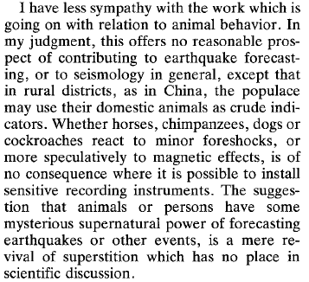
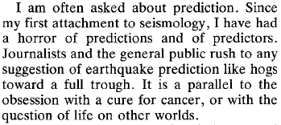
Richter (1977) - BSSA

Slide 7
- Susan Hough “Richter Scale: Measure of an Earthquake, Measure of a Man” (2007)

Slide 8
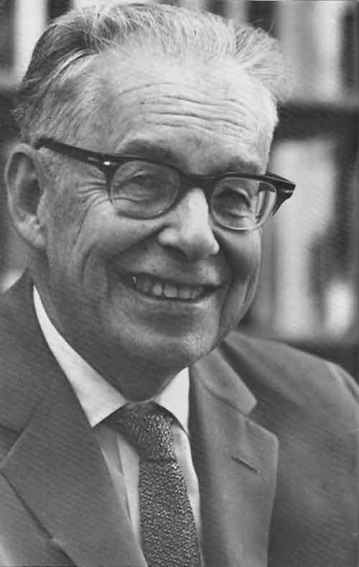
The Quidnunc’s ‘Richter Scale’
Charlie Richter made a scale for calibrating earthquakes Gives a true and lucid reading ev'ry time the earth shakes Increments are exponential; numbers O to 9 When the first shock hit the "seismo", everything worked fine It measured one-two (1.2) on the Richter scale A shabby little shiver One-two on the Richter scale A queasy little quiver Waves brushed the seismograph As if a fly had flicked her One-two on the Richter scale; It hardly woke up Richter

Slide 9
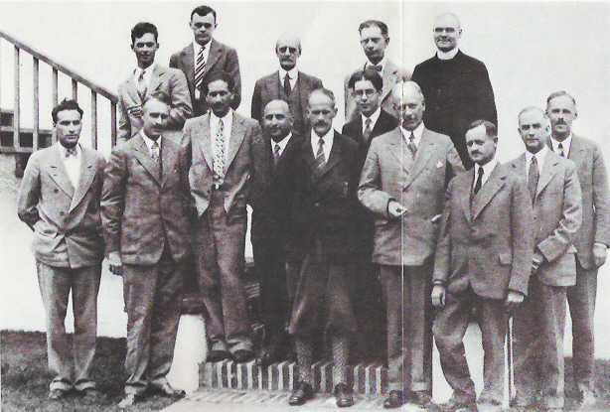
Hugo Benioff
Perry Byerly
Harry F. Reid
Charles Richter
L. H. Adams
Beno Gutenberg
Sir Harold Jeffreys
Harry O. Wood

